Slide 1
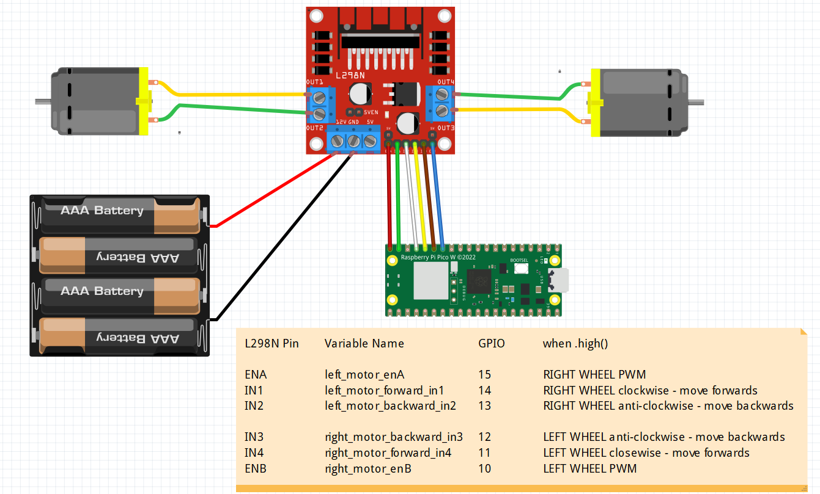
PINS ON THE LN298
ENA
Left wheel Throttle
Left Motor Forward
Right Motor Forward
ENB
Right wheel Throttle
Left Motor Backward
Right Motor Backward
on

Slide 2
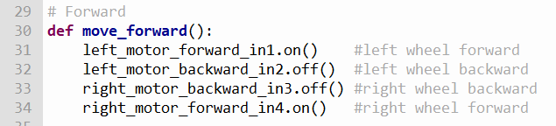
PINS ON THE LN298
ON-Move Forward
on

Slide 3
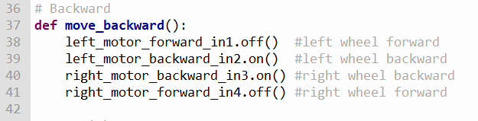
ON-Move Backward

Slide 4
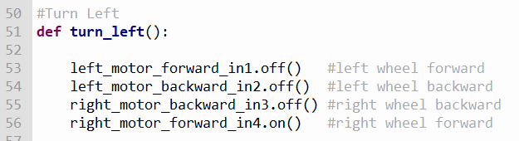
PINS ON THE LN298
TURN LEFT
on

Slide 5
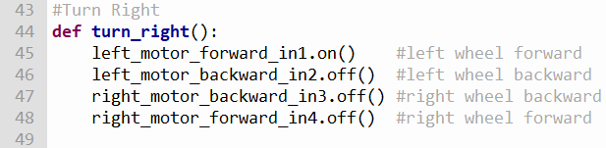
PINS ON THE LN298
TURN RIGHT
on

Slide 6
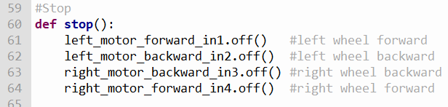
PINS ON THE LN298
STOP
on

Slide 7
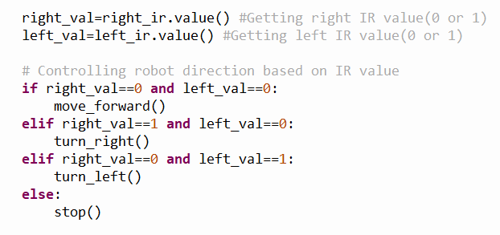
HOW THE IR SENSOR WORKS
1
1
0
0
1
1
0
0
ROBOT
VEERS LEFT
ROBOT
VEERS RIGHT
ROBOT
STOPS
ROBOT
ON COURSE
CORRECTION
MOVE RIGHT
CORRECTION
MOVE LEFT

Slide 8
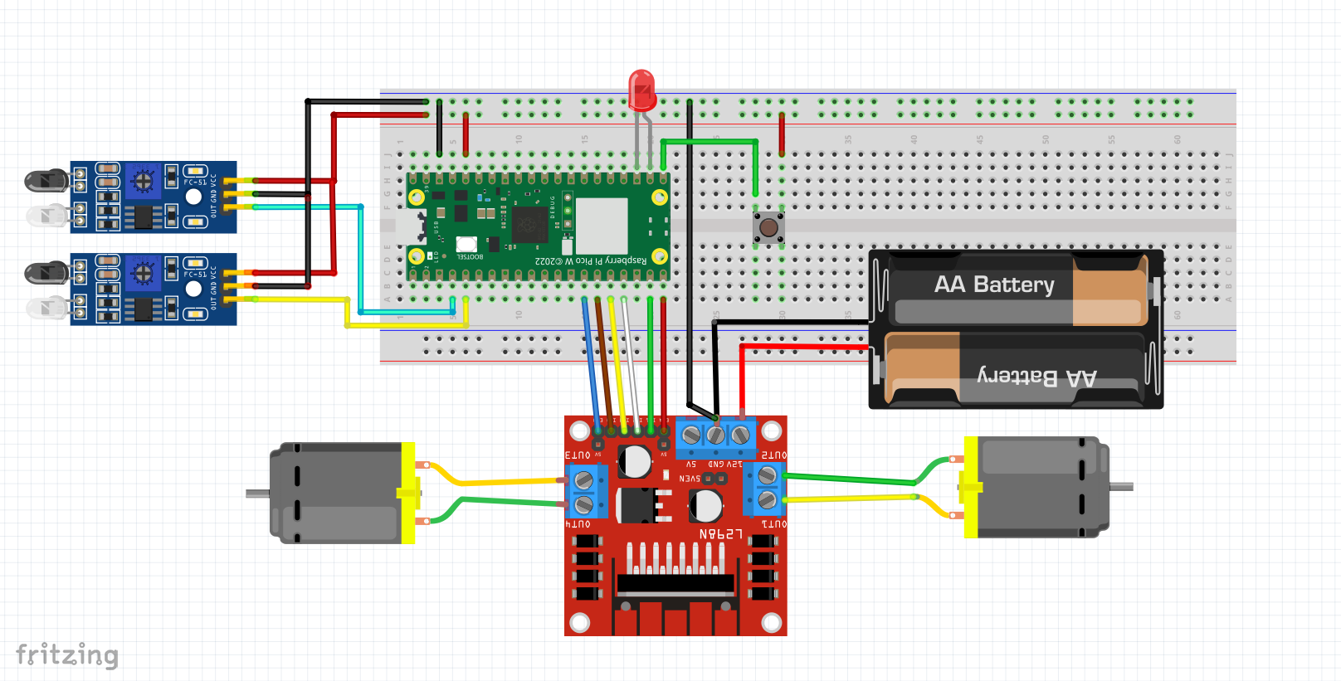
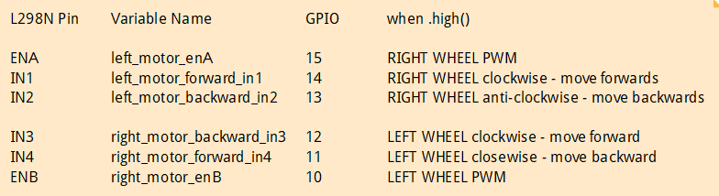
GPIO17
GPIO16
GPIO2
GPIO 3

